Slide 1

Slide 2
𝗖𝗼𝗳𝗳𝗲𝗲 𝗦𝗵𝗼𝗽 𝗦𝗮𝗹𝗲𝘀 𝗔𝗻𝗮𝗹𝘆𝘀𝗶𝘀
-By Ansh Rathod

Slide 2


Slide 5
Recommended Analysis
How do sales vary by day of the
week and hour of the day?
Are there any peak times for sales
activity?
What is the total sales revenue for
each month?
How do sales vary across different
store locations?

Slide 3
Slide 5
Recommended Analysis
What is the average price/order
per person
Which products are the best selling in terms of quantity and revenue?
How do sales vary by product
category and type?

Slide 4
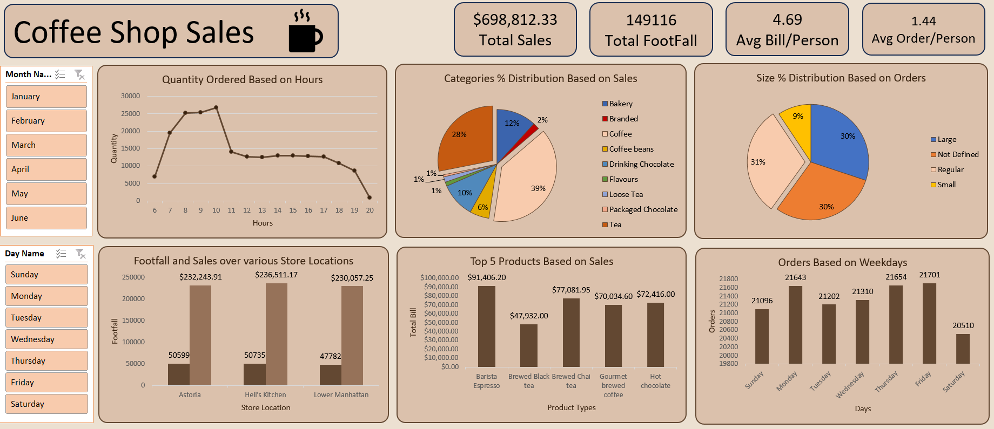
Slide 13
DASHBOARD
Orders/Hours
Different Products Based on Sales
Size Ordered
Sales & Footfall across Different Store Locations
Top 5 Products

Slide 5

Slide 6
Conclusion
The Coffee Shop Sales Analysis uncovers key insights that can drive smarter decision-making and operational improvements:
Top Performers: Coffee and Tea categories drive the majority of revenue, ideal for seasonal promotions.
Peak Sales Times: Morning hours (8–10 AM) and weekends show the highest footfall and sales activity.
Growth Areas: Coffee Beans, Loose Tea, and months like February show opportunities for improvement.
Strategic Focus: Insights can boost customer satisfaction, increase revenue, and streamline operations.

Slide 6
Slide 2
THANK YOU
-By Ansh Rathod
Email : anshrathod735@gmail.com
Contact :
+918104910280

